Slide 1
Information System Analysis and Design of “Rajshahi Sugar Mills Ltd.”
Presenting By:
1.Nazmul Hossain Anik (1703146)
2.Nadia Subrin (1703147)
3.Md Rakibul Hasan (1703148)
4.Mohammad Mohiuddin (1703149)
5.Joytun Sultana (1703150)

Slide 2
Introduction:
Rajshahi Sugar Mills Limited aka Haryana Sugar Mills is a heavy industrial enterprise located in Harian Union of Paba Upazila in Rajshahi District of Rajshahi Division in northwestern Bangladesh. It is one of the major sugar mills in Bangladesh.
The construction of this industrial plant started in 1962 and was completed in 1965 and it started producing sugar from 1965-66.

Slide 3
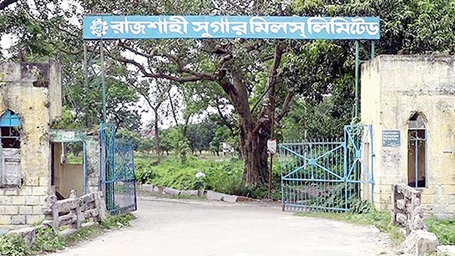
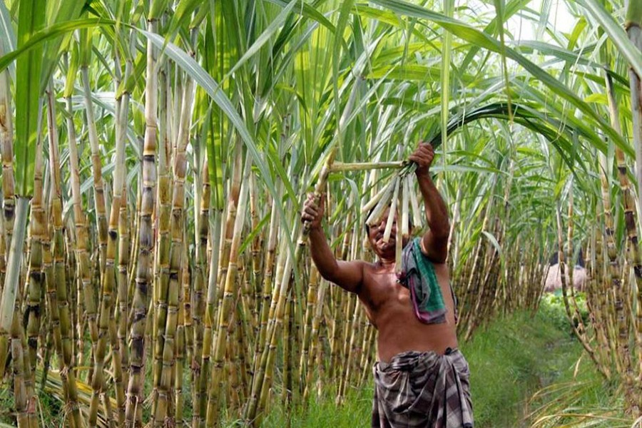
Fig: Sugar Cane Field
Fig: Rajshahi Sugar Mills Ltd.

Slide 4
Vision and Mission
Vision
Mission
Increase profit by increasing quality of sugar.
To produce quality seeds of desired species of sugarcane and distribute them among the farmers.

Slide 5
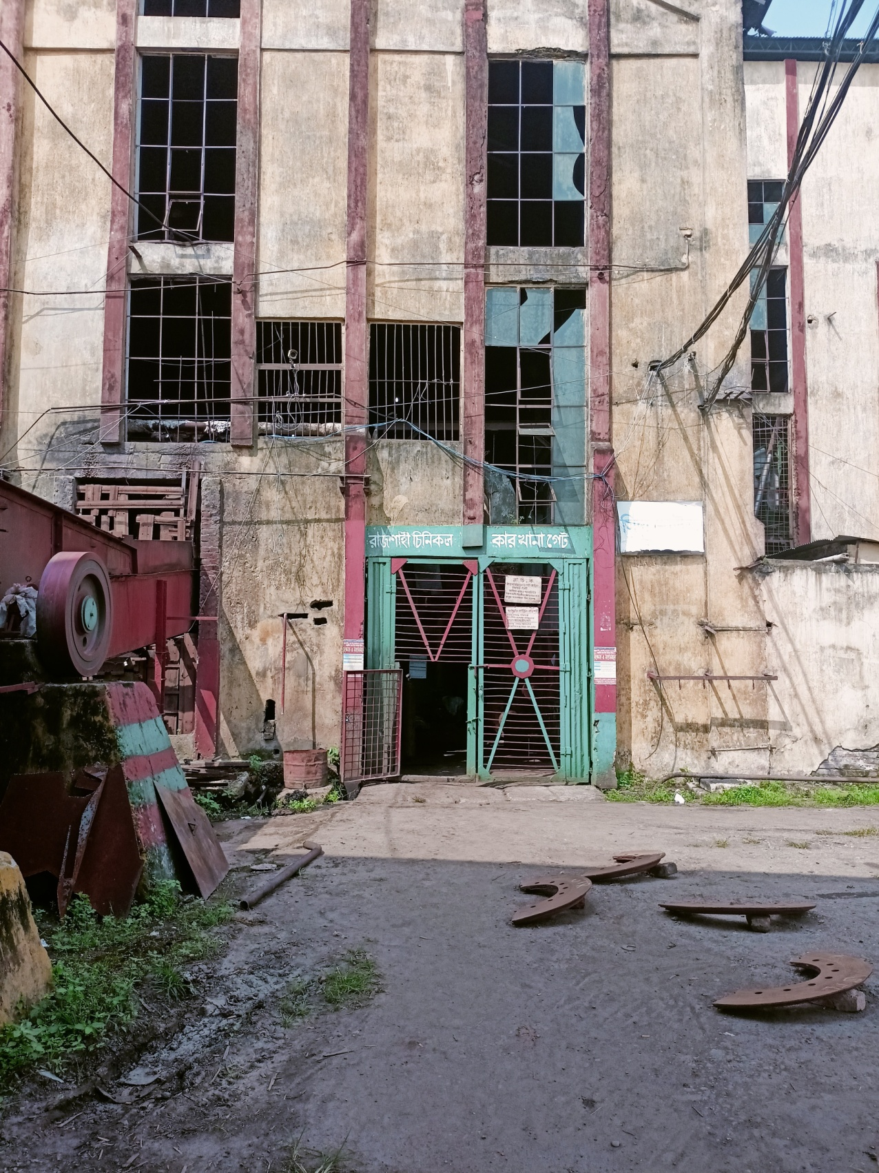
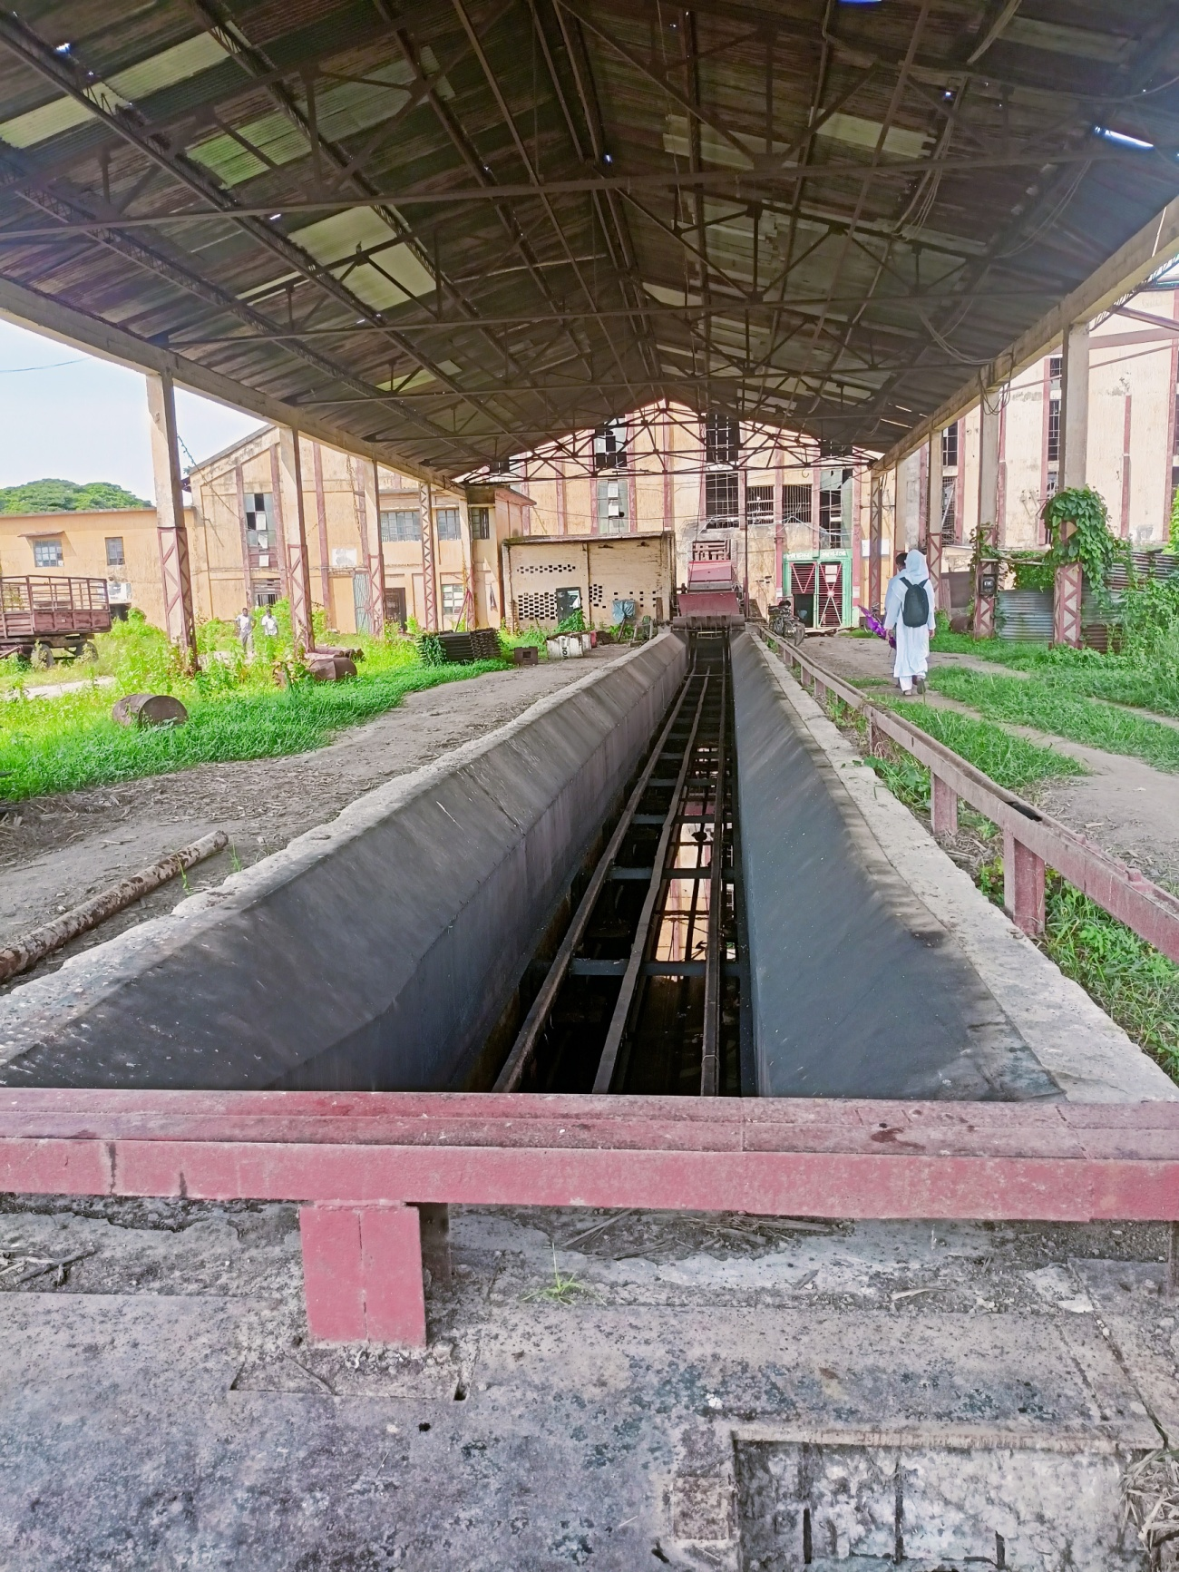
On-Site Observation and Problem Analysis:
Onsite observation is the most useful way of information collection.

Slide 6
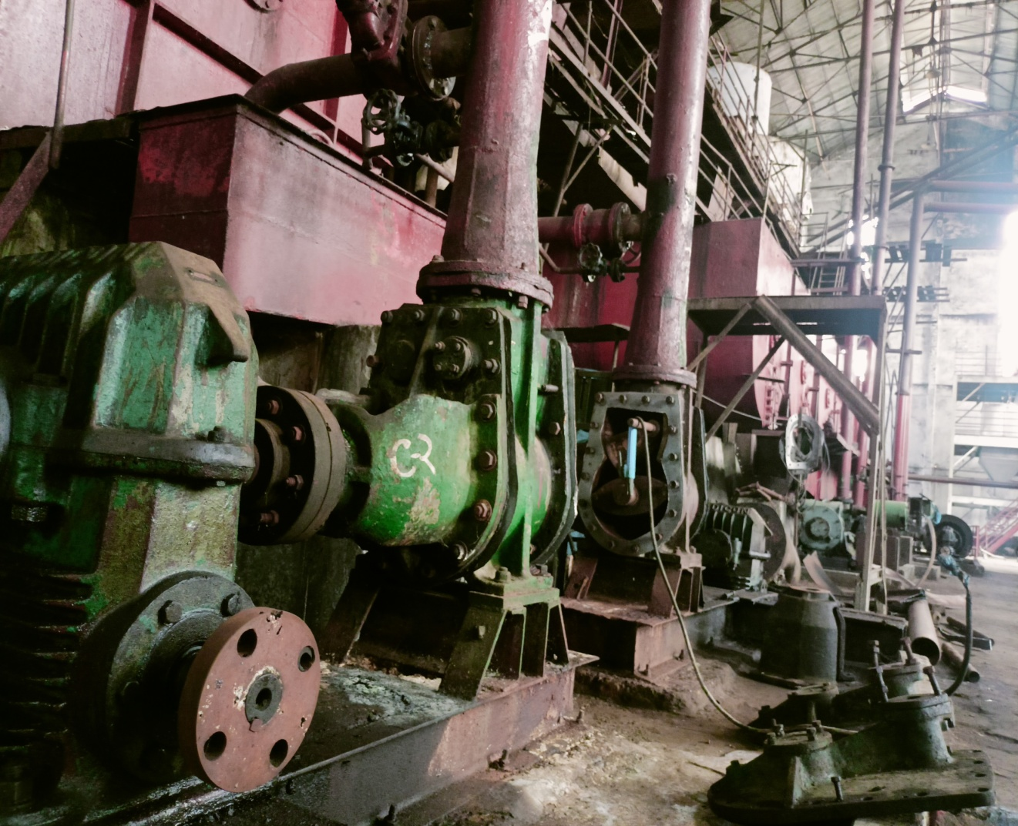
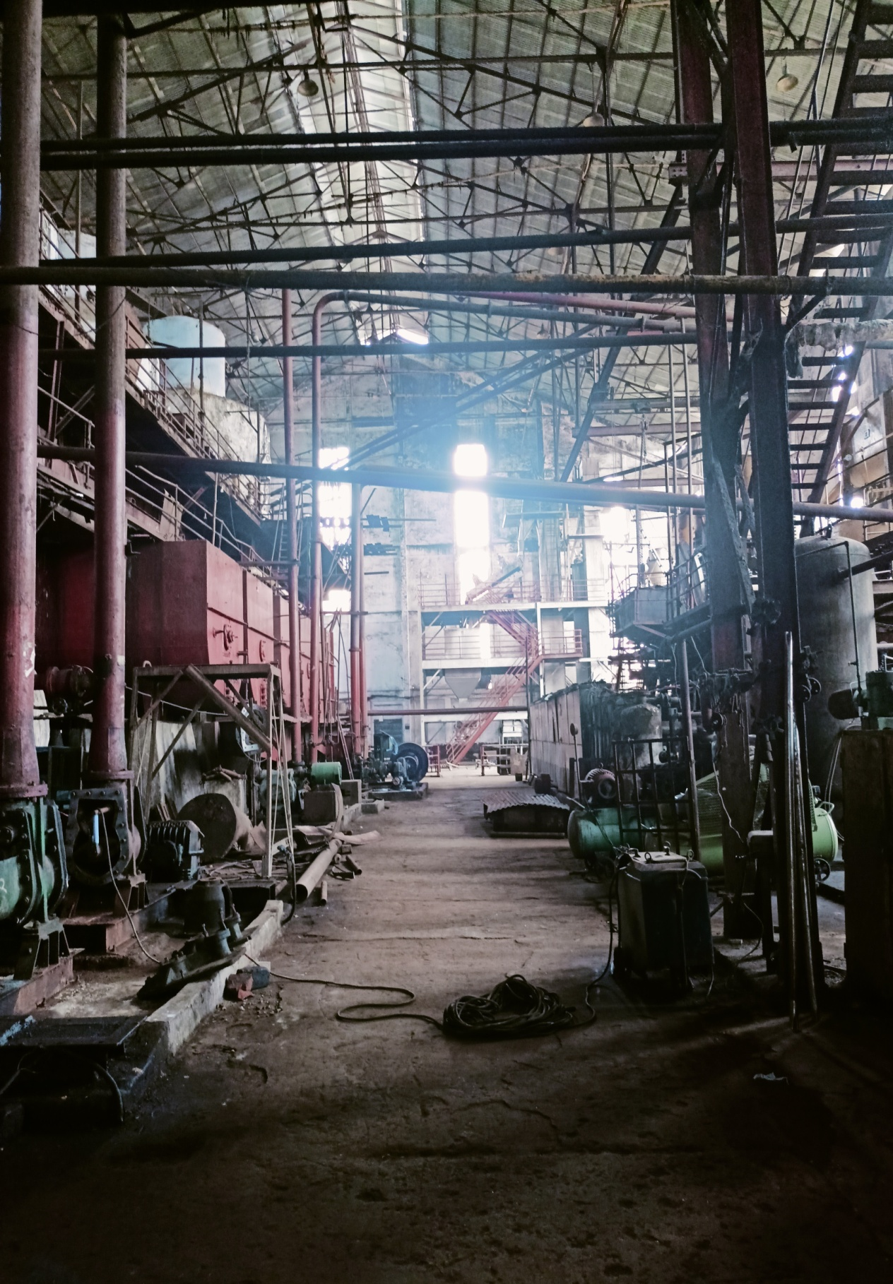
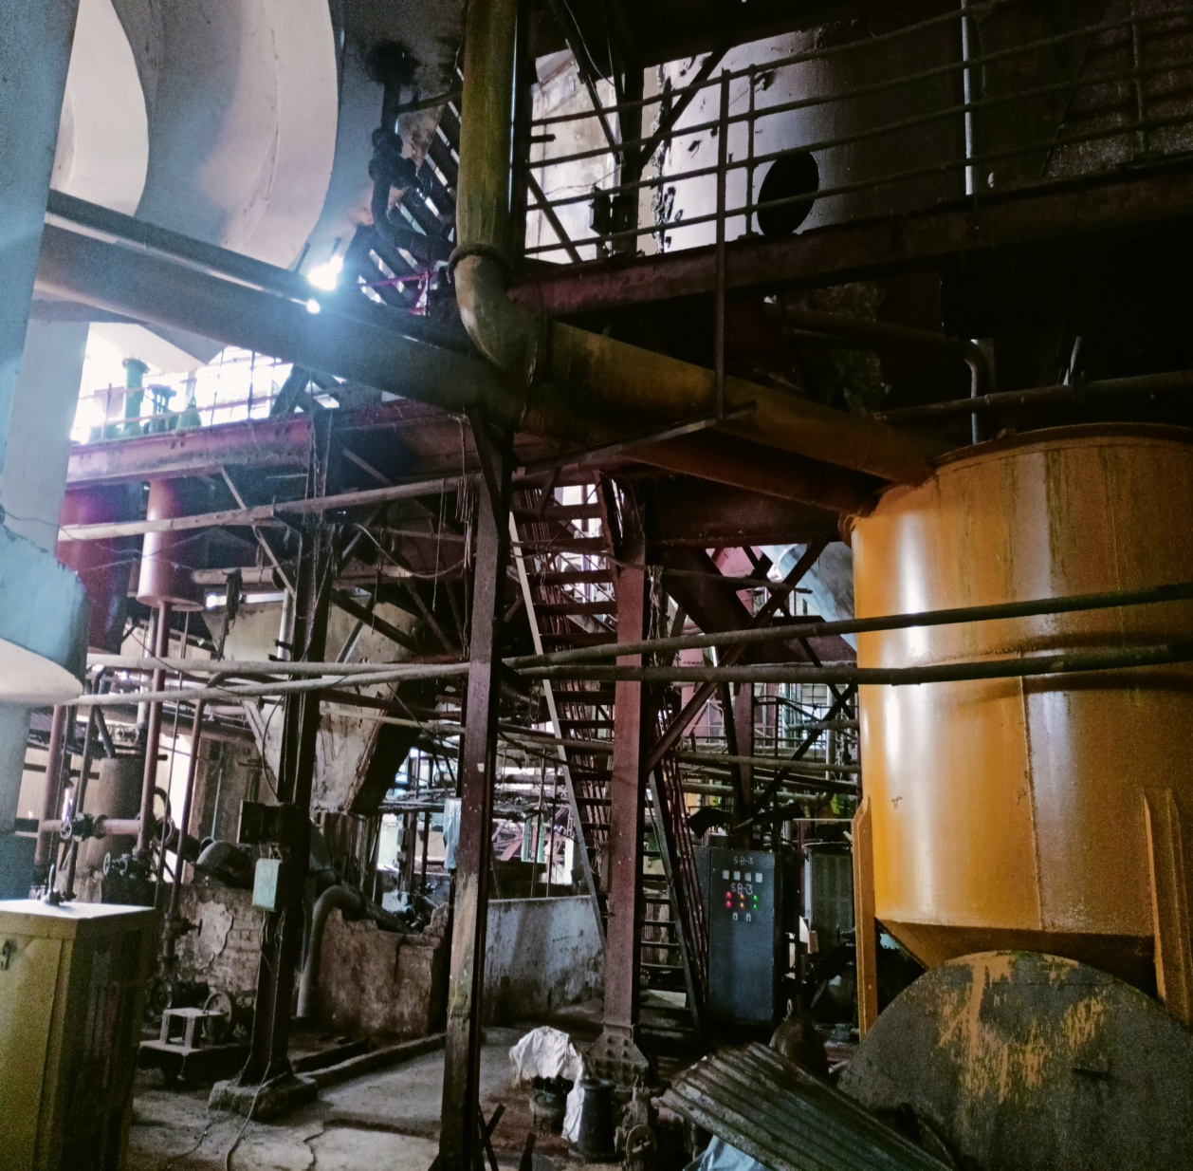
Fig: Inside the factory (1).
Fig: Inside the factory (3).
Fig: Inside the factory (2).

Slide 7
Interviews
Questionaries
Problem Analysis
Machineries
High quality Sugarcane

Slide 8
Structured Analysis:
Data Flow Diagram(DFD)
Data Dictionary(DD)
Decision Tree(DT)

Slide 9
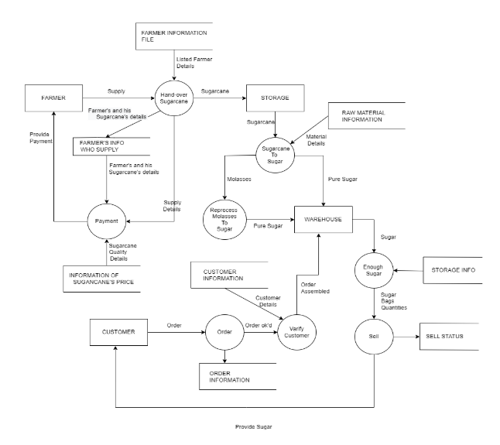
Data Flow Diagram(DFD):

Slide 10
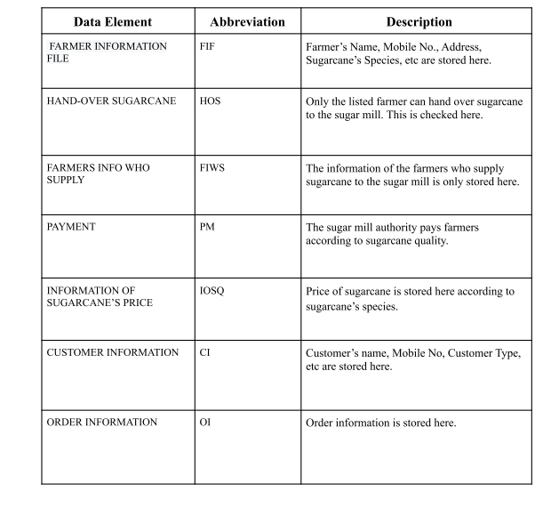
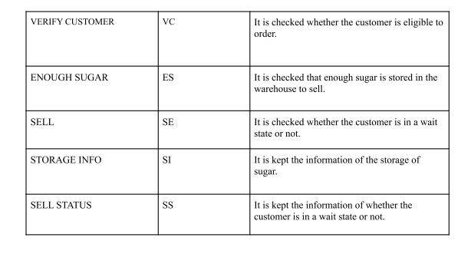
Data Dictionary(DD):

Slide 11
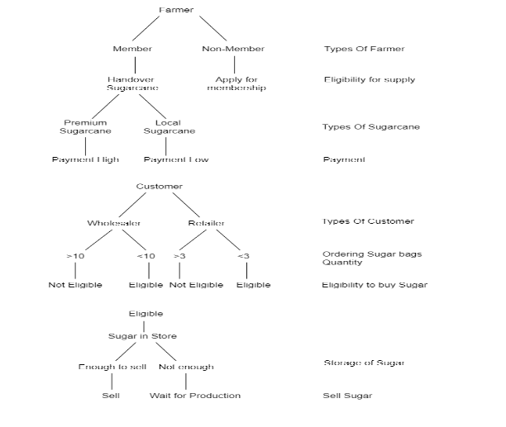
Decision Tree(DT):

Slide 12
Candidate System
Candidate System 1:
Servicing machineries
Digital management system
digitalized payment system (Mobile Banking)
Collaboration with Bangladesh Sugarcrop Research Institute (BSRI)
Establish Sugarcane R&D department.
Provide good quality sugarcane species

Slide 13
Candidate System
Candidate System 2:
Replacing Machineries
Digital Management System
Bank based Payment System
Automated Production System
import better quality sugarcane species

Slide 14
Comparison between two Candidate System:
Table: Characteristics of two potential candidate system:
Characteristics | Candidate System 1 | Candidate System 2
Management System | Computerized | Computerized
Payment System | Mobile Banking | Renown Bank
Production System | Manually | Automated
Distribution System | Digitalized | Digitalized
Storage management | Computerized | Computerized

Slide 15
Comparison between two Candidate System:
Table: Qualitative Evaluation Matrix
Evaluation Criteria | Candidate System 1 | Candidate System 2
Working Environment | Good | Very Good
Efficiency | Good | Very Good
Payment System | Good | Good
Employee Training | Fair | Good
Research Opportunity | Very Good | Not Good
System Management | Good | Good

Slide 16
Comparison between two Candidate System:
Table: Performance/Cost Evaluation Matrix
Evaluation Criteria | Candidate System 1 | Candidate System 2
Efficiency | 60% | 80%
Employee Satisfaction | 70% | 90%
Machine cost | 4-5 lac BDT | 1-1.5 crore BDT
Payment system | 70% satisfied | 50% satisfied
Research Cost | 50-60 lac | N/A
Import Cost | N/A | 70/80 lac

Slide 17
Comparison between two Candidate System:
Table: Weighted Candidate Evaluation Matrix
Evaluation Criteria | Weighting Factor | Candidate System 1 |  | Candidate System 2
Management | 2 | 4 | 8 | 4 | 8
Machine Cost | 5 | 5 | 25 | 2 | 10
Working Environment | 3 | 3 | 9 | 4 | 12
Research / import (New species) | 4 | 4 | 16 | 3 | 12
Payment system | 3 | 4 | 12 | 3 | 9
 |  |  | Total=70 |  | Total=51

Slide 18
Conclusion:
Best Candidate System:
The system which has the highest total is considered as the best system. We have found that the candidate system-1 has the highest value. So, candidate system-1 is the best proposed system for Rajshahi sugar mill.

Slide 19
Thank You!
Any Query?

